Slide 1
The Battle of Neighborhoods
Analysis of Opening Japanese Restaurant in Toronto
Paulina Kossowska
June 2021

Slide 2
Introduction

Slide 3
Background
Problem
Target Audience
Toronto - the city of possibilities. Toronto is Canada’s largest city and a world leader in such areas as business, finance, technology, entertainment and culture. All these factors make Toronto an attractive place to live, work or start a business. What is definitely worth mentioning is the fact that thanks to the multiculturalism of this city, we are able to taste the best flavours of cuisines from around the world.
Imagine a situation where there is a descendant of immigrants from Japan (let's call him Paul) and he is currently living in the most density city in Canada - Toronto. Paul has a lot of doubts where he should open his business. Through this analysis I will help Paul decide to choose the best neighborhood in Toronto for his Japanese restaurant.
The aimed audience for this project could be an entrepreneur or business owner who want to open a Japanese restaurant in Toronto or who is interesting to improve the business proficiency of existing business.

Slide 4
Data

Slide 5
1. List of postal codes from Toronto
2. Geographical coordinates of each neighbourhoods in Toronto
3. Japanese restaurants in each neighbourhoods in Toronto using Foursquare API
4. Toronto GeoJSON file
5. Immigration and ethnocultural diversity statistics
6. Business Improvement Areas: is an association of commercial property owners and tenants within a defined area who work in partnership with the City to create thriving, competitive, and safe business areas that attract shoppers, diners, tourists, and new businesses

Slide 6
Methodology

Slide 7
My first step in discovering potential areas for a new Japanese restaurant in Toronto will be an exploratory data analysis. Through this I will visualise interesting perceptions.
My second step in this analysis will be performing machine learning algorithm. For the purpose of this project I choose DBSCAN: a density-based clustering algorithm which is appropriate to use when examining spatial data.
This analysis will help me identifying different cluster groups and defined it as potential candidates’ locations for a new Japanese restaurant in Toronto.

Slide 8
Exploratory Data Analysis

Slide 9
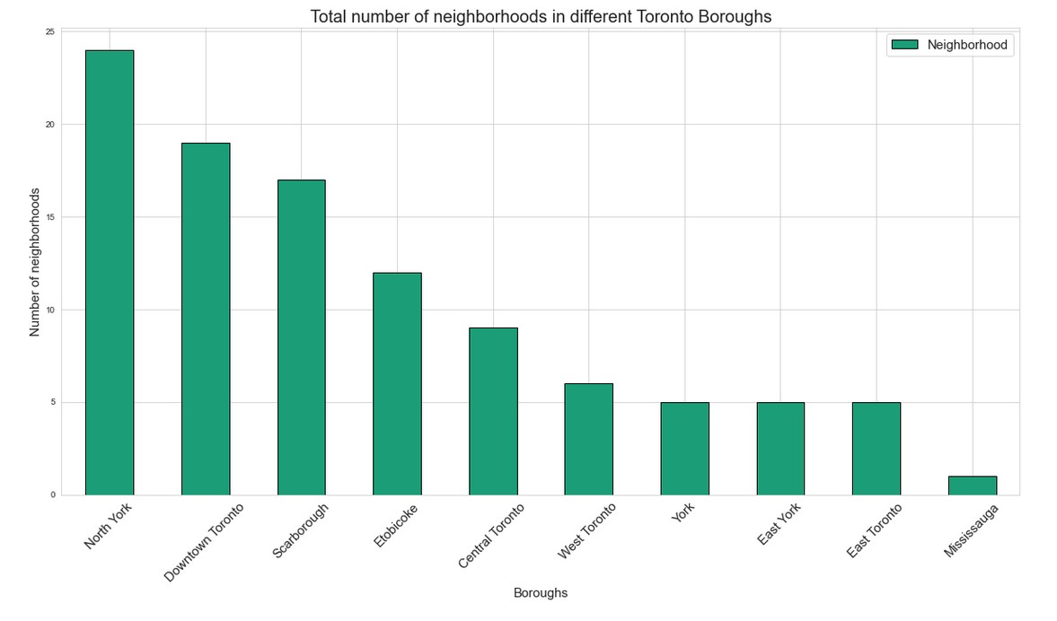
Explore the neighborhoods in Toronto

Slide 10
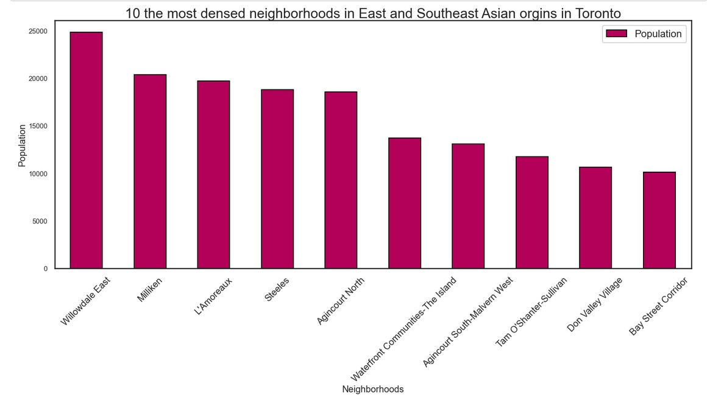
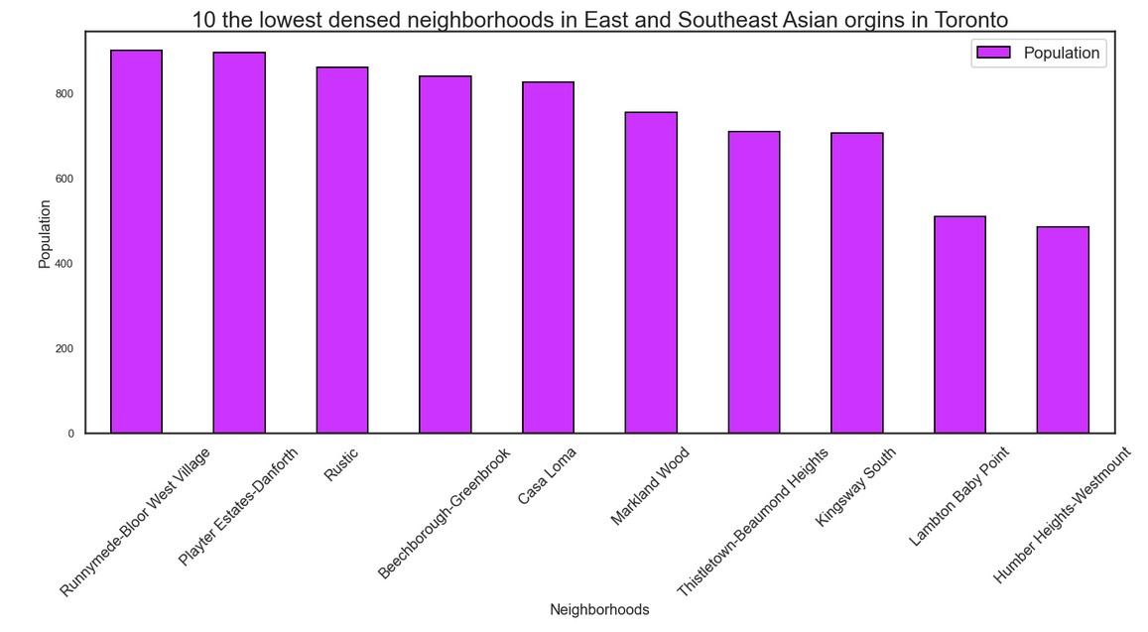
Explore East and Southeast Asian population in Toronto

Slide 11
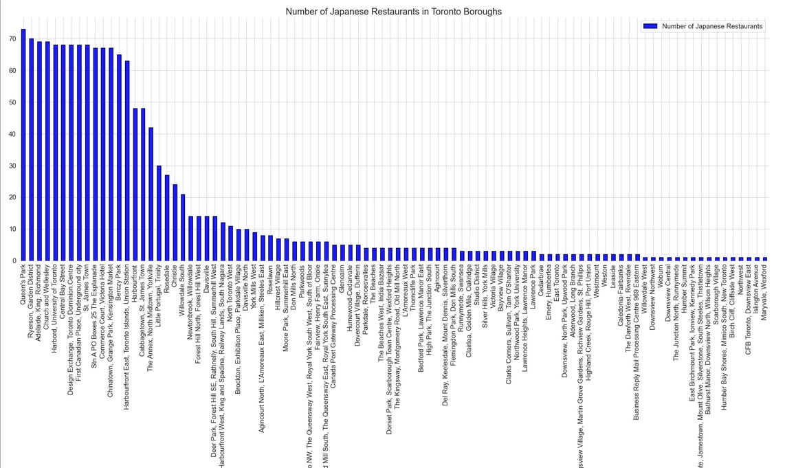
Explore Japanese Restaurants in Toronto

Slide 12
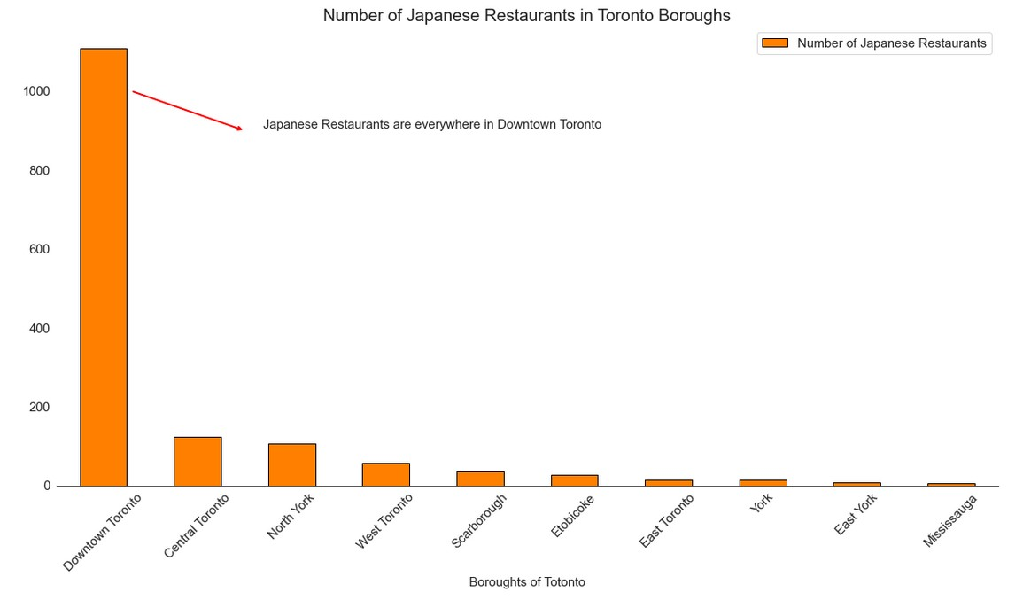
Explore Japanese Restaurants in Toronto

Slide 13
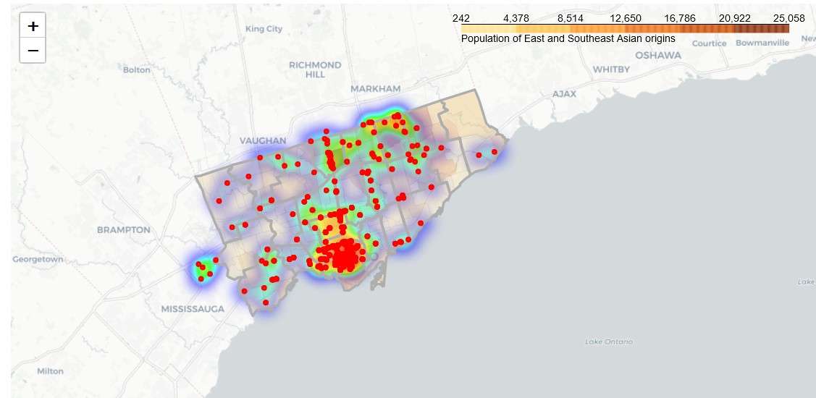
Create a heatmap for Japanese Restaurants in Toronto

Slide 14
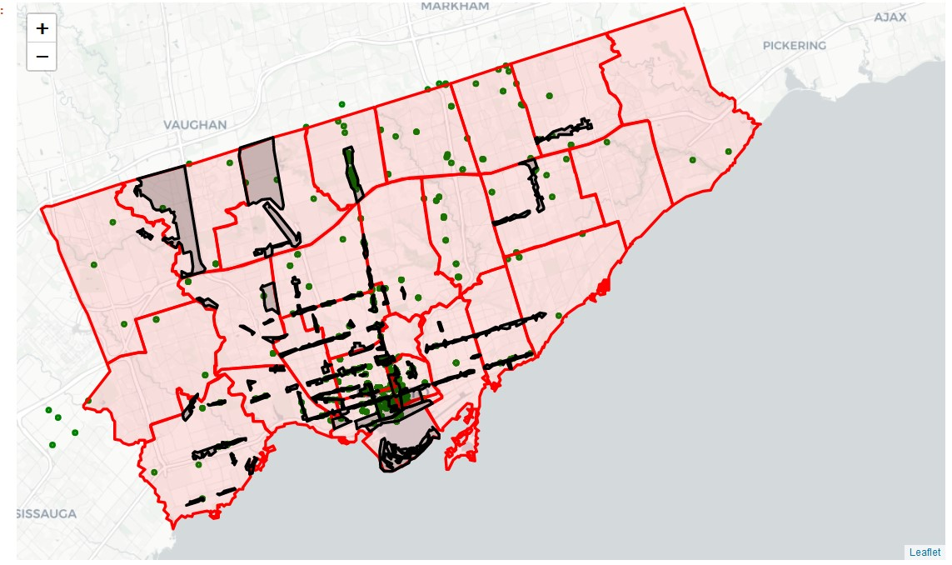
Create a Business Improvement Areas of Toronto with Japanese Restaurants

Slide 15
Density based clustering:
DBSCAN

Slide 16
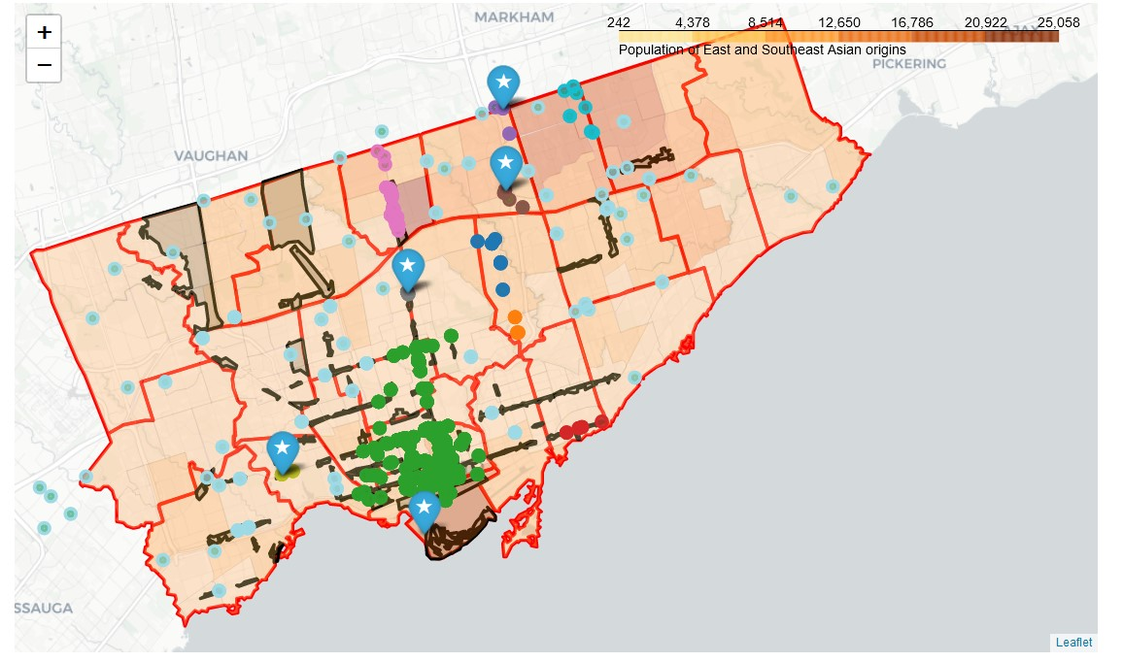
DBSCAN Results Visualization

Slide 17
Discussion

Slide 18
Cluster 0: Fair
Out of BIA
Moderate population density of East and Southeast Asian origins
Moderate density of Japanese Restaurants
Cluster 1: Not Recommended
Out of BIA
Low population density of East and Southeast Asian origins
Low density of Japanese Restaurants
Cluster 2: Potential
In of BIA
High population density of East and Southeast Asian origins
High density of Japanese Restaurants
Cluster 3: Fair
In of BIA
Low population density of East and Southeast Asian origins
Moderate density of Japanese Restaurants

Slide 19
Cluster 4: Potential
Out of BIA
High population density of East and Southeast Asian origins
Low density of Japanese Restaurants
Cluster 5: Potential
Out of BIA
Moderate population density of East and Southeast Asian origins
Low density of Japanese Restaurants
Cluster 6: Not Recommended
In of BIA
High population density of East and Southeast Asian origins
High density of Japanese Restaurants
Cluster 7: Potential
In of BIA
Low population density of East and Southeast Asian origins
Low density of Japanese Restaurants

Slide 20
Cluster 8: Potential
In of BIA
Low population density of East and Southeast Asian origins
Low density of Japanese Restaurants
Cluster 9: Not Recommended
Out of BIA
High population density of East and Southeast Asian origins
Moderate density of Japanese Restaurants
Cluster 10: Fair
In of BIA
Low population density of East and Southeast Asian origins
Moderate density of Japanese Restaurants

Slide 21
Limitations

Slide 22
One of important limitations worth to mention is a fact that data used in this project was obtained from Open Data city of Toronto and based on Census results from 2016 year.
Immigration and ethnocultural diversity statistics like neighbourhood profiles data, Business Improvement Areas data and GeoJSON ward data are based on results of 2016 Census in Canada.
Current 2021 year are the year for conducting new Census in Canada, so if the data will be available could be used to improve density population map or business improvement area map. New Census data could bring new insight about neighbourhoods’ profiles in city of Toronto.

Slide 23
Thanks for Attention

